Slide 1
Dog DOMINI
Proactive Conversational Accessibility System

Slide 2
DOMINI
Hardware-Triggered Chat Interface for Inclusive Digital Interaction
Platform: PyQt6 Desktop
Interaction: Hardware + Voice + Chat
Task: Accessible Email Composition

Slide 3
Problem Statement
Accessibility Still Assumes User Initiative
Most digital systems require users to:
Locate the correct app
Open the interface
Configure accessibility settings
Initiate interaction manually
For users with:
Motor impairments
Cognitive difficulties
Attention or memory challenges
Even starting the task is a barrier

Slide 4
Key Accessibility Gap
Interfaces Do Not Adapt to User Presence
Systems wait for user input
No awareness of user intent or context
Accessibility tools are passive, not proactive

Slide 5
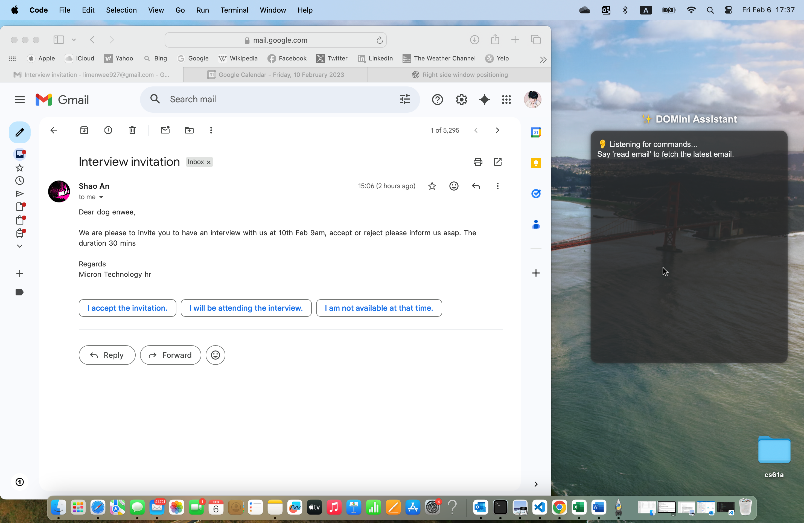
Our Solution
Hardware-Triggered Conversational Interface
We built a system that:
Detects when a person approaches the laptop
Automatically launches a chat-based accessibility assistant
Allows immediate voice or text interaction
Completes tasks (email) without traditional UI navigation
Accessibility activates when needed, not manually

Slide 6
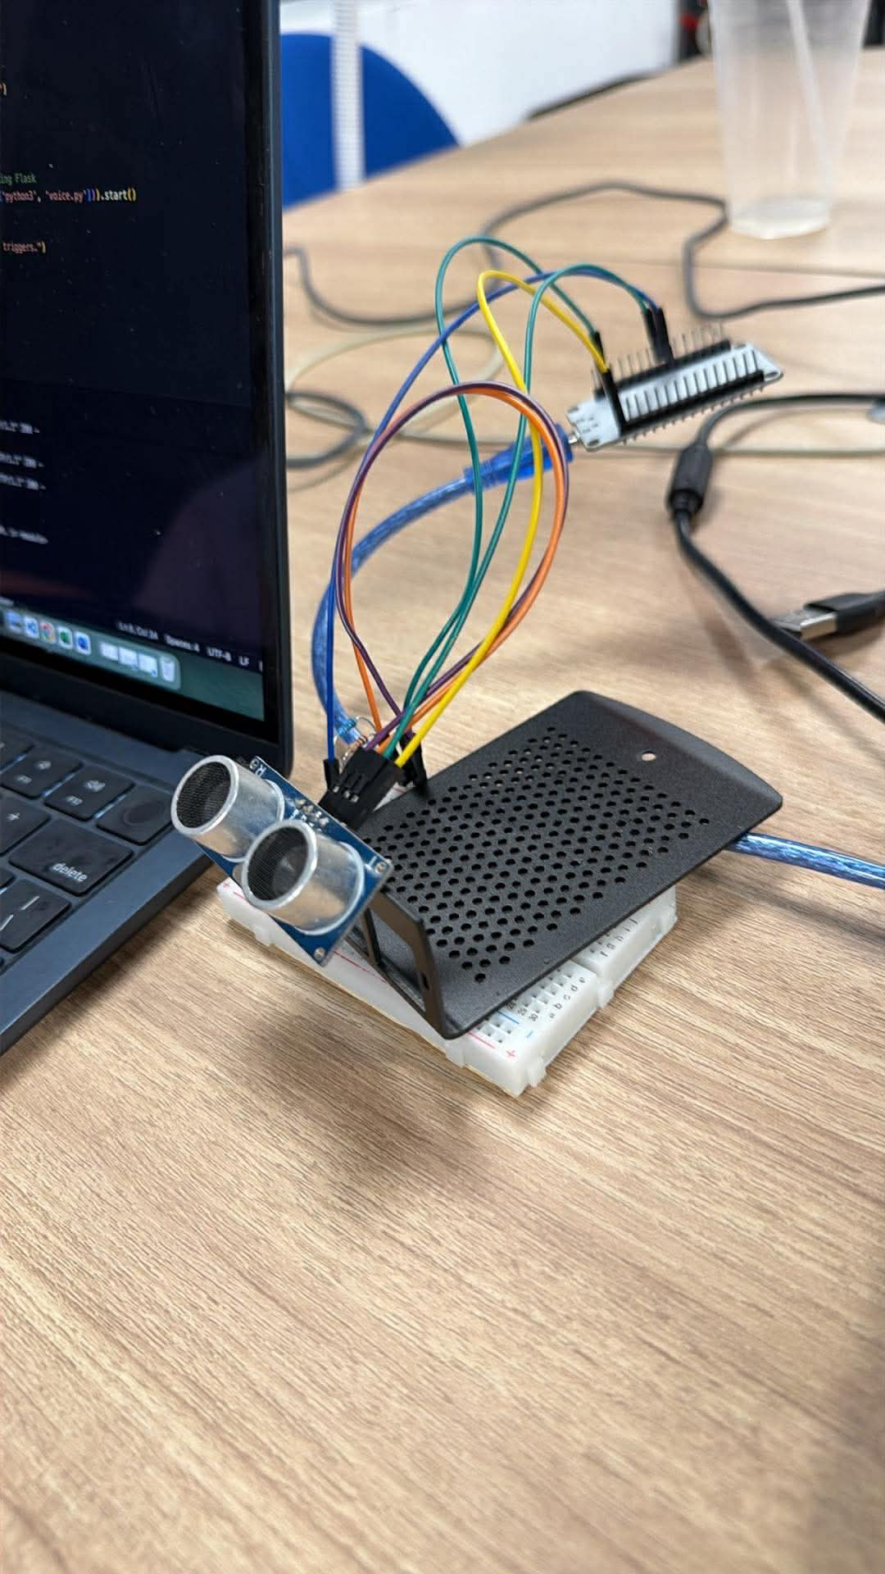
Why Hardware + AI Is Necessary
Hardware
Detects real-world user presence
Removes the need to search or click
AI
Interprets natural speech
Converts intent into structured actions
Adapts output dynamically

Slide 7
End-to-End System Architecture
Fully Integrated Pipeline
Presence Detection (Hardware Sensor)
Automatic Chat UI Launch (PyQt6)
Voice or Text Input
AI Email Draft Generation
User Confirmation via Chat
Automated Email Sending (Gmail API)
End-to-end
Executable
Demo-ready

Slide 8
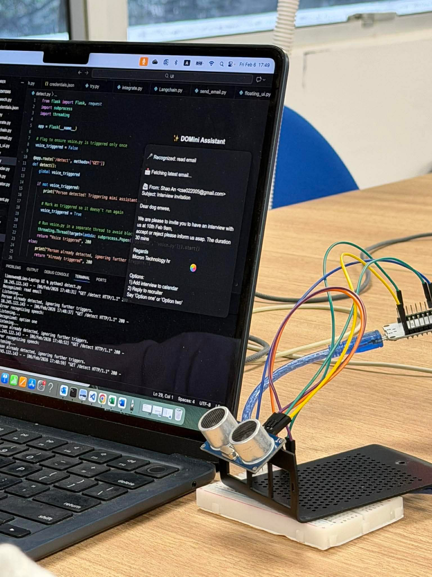
Accessibility Impact (Before vs After)
Before
After
User must:
Open laptop
Find app
Navigate UI
Type content
High cognitive and motor demand
System detects user presence
Chat interface appears automatically
User speaks naturally
Email sent independently
Reduced steps
Reduced cognitive load
Increased independence

Slide 9
Real-Time Performance & Reliability
Hardware detection: instant
Chat UI launch: immediate
Speech recognition: real-time
AI response: ~1–2 seconds
Stable under repeated interactions
Design choice:
Fast, predictable feedback prioritized for accessibility.

Slide 10
Innovation & “Wow Factor”
What Makes This Stand Out
Accessibility that initiates itself
Context-aware interface
Hardware + AI + UI tightly integrated
Moves beyond screen readers or static settings

Slide 11
Conclusion
Key Takeaways
Solves a real accessibility barrier
Proactive, not reactive
Fully functional system
Clear real-world impact
True accessibility begins before the user asks for it.

Slide 12
Thank You

